Slide 1
Time Series Forecasting
Accompanying Data source/graphs

Slide 2
Objective
Forecasting TS data of retail sales of last two decades adjusting for inflation .
Step-by-step procedure and data source provided for replication (& modification)
The r-script and excel/csv adjustment data is also provided for ease of replication and referencing.
Expect a similar but a smaller case study based on ts dataset in Exam.
Check the folder TS_1

Slide 3
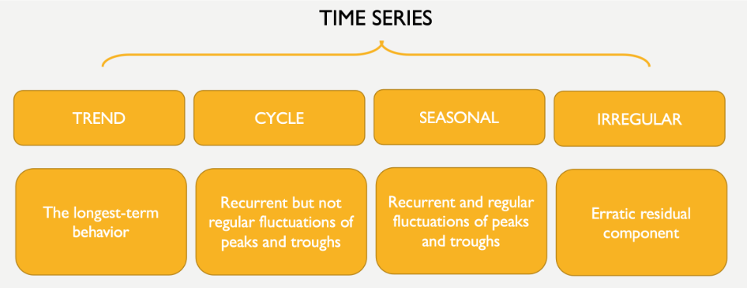
Introduction to Time Series : application

Slide 5
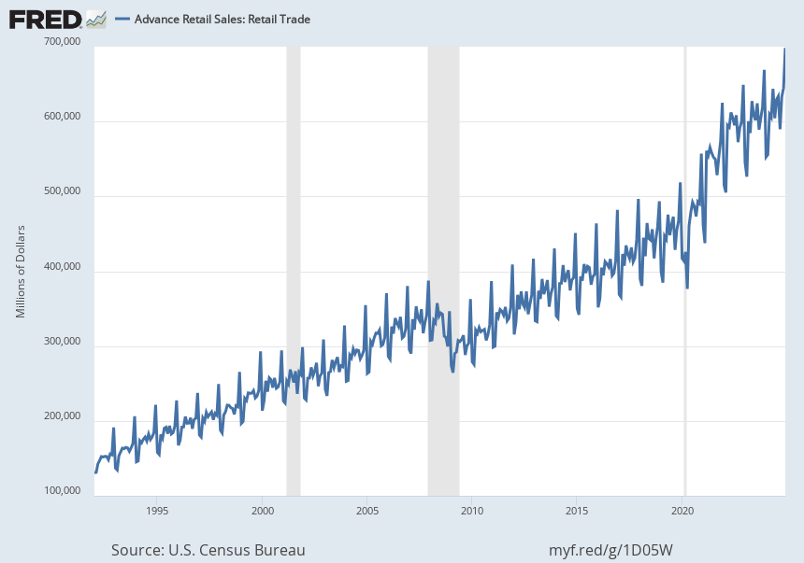
Notes:
Source: U.S. Census Bureau Release: Advance Monthly Sales for Retail and Food Services Units: Millions of Dollars, Not Seasonally Adjusted Frequency: Monthly E-commerce sales are included in the total monthly sales estimates. The value for the most recent month is an advance estimate that is based on data from a subsample of firms from the larger Monthly Retail Trade Survey. The advance estimate will be superseded in following months by revised estimates derived from the larger Monthly Retail Trade Survey. The associated series from the Monthly Retail Trade Survey is available at https://fred.stlouisfed.org/series/MRTSSM44000USN Information about the Advance Monthly Retail Sales Survey can be found on the Census website at https://www.census.gov/retail/marts/about_the_surveys.html U.S. Census Bureau, Advance Retail Sales: Retail Trade [RSXFSN], retrieved from FRED, Federal Reserve Bank of St. Louis; https://fred.stlouisfed.org/series/RSXFSN, January 17, 2025.

Slide 6
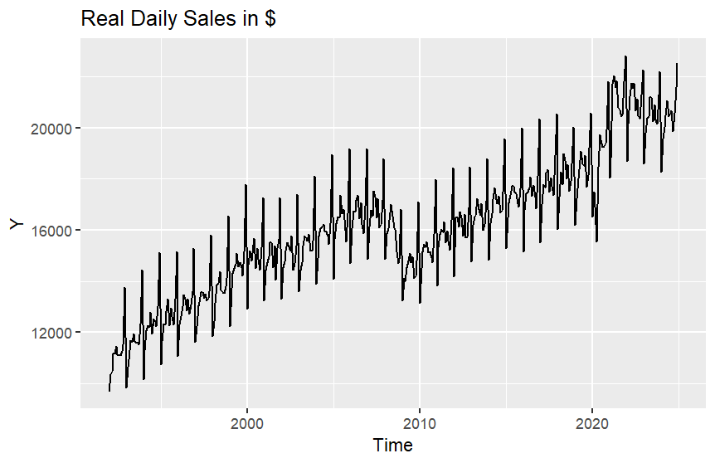

Slide 7
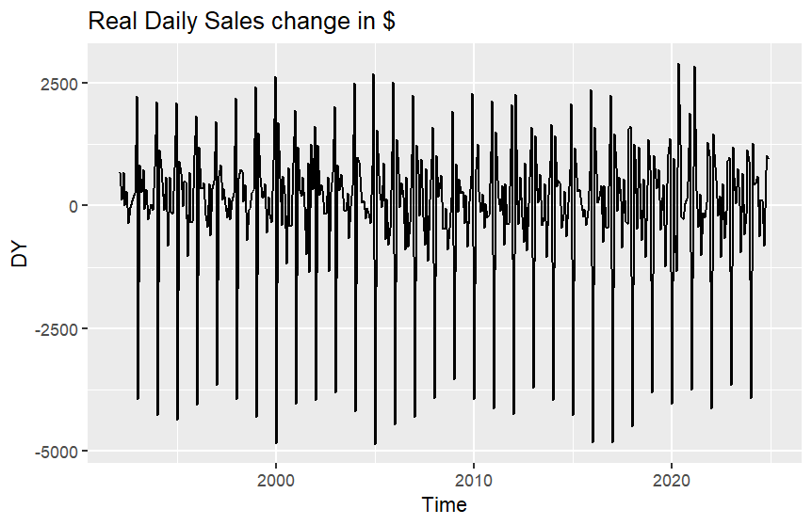

Slide 8
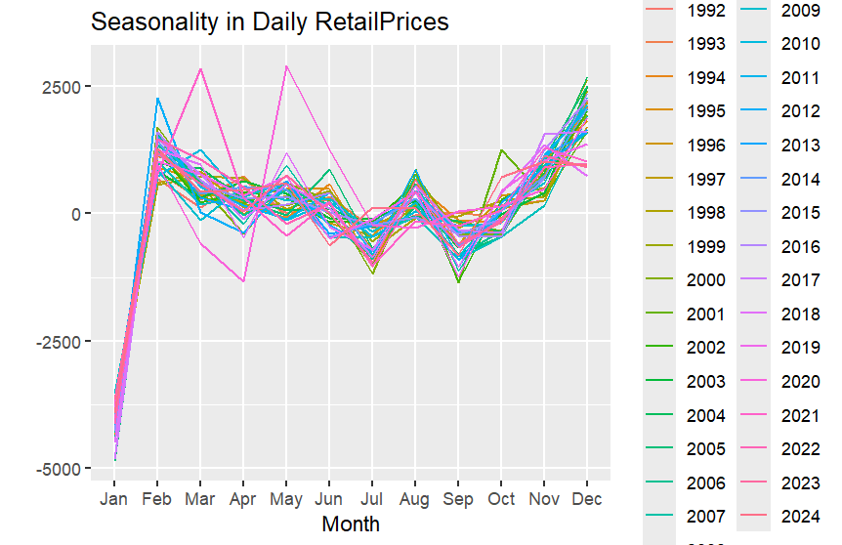

Slide 9
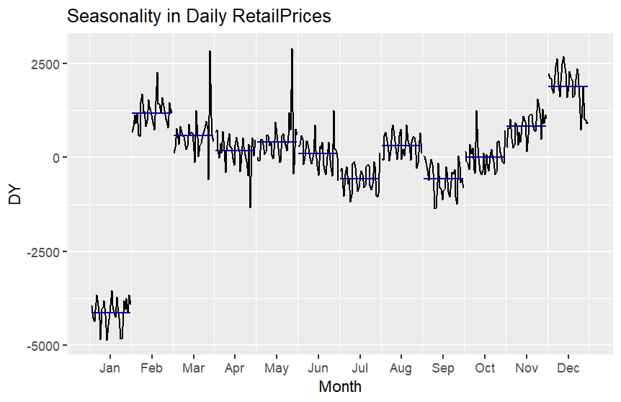

Slide 10
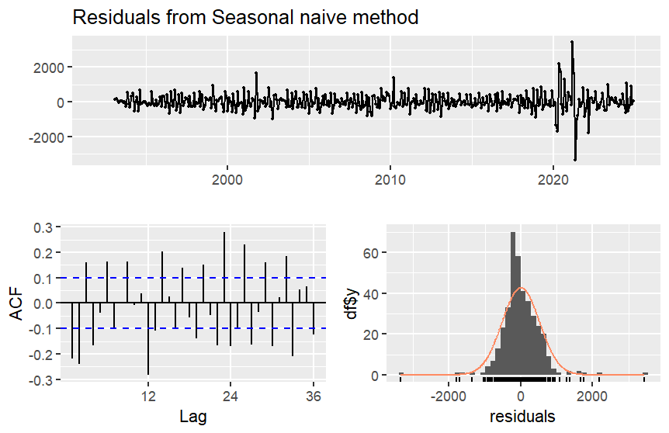

Slide 11
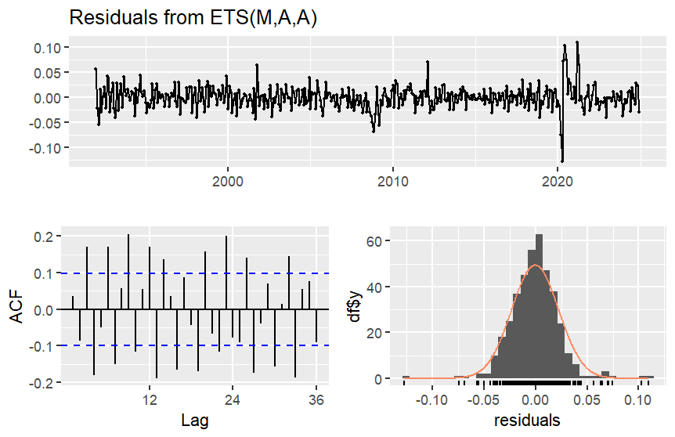

Slide 12
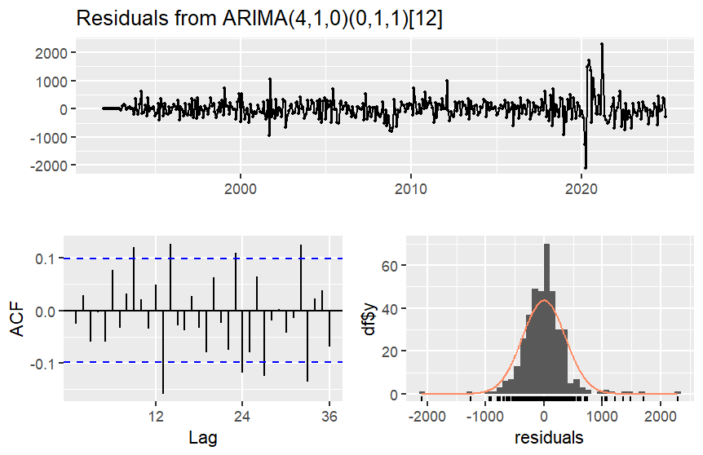

Slide 13
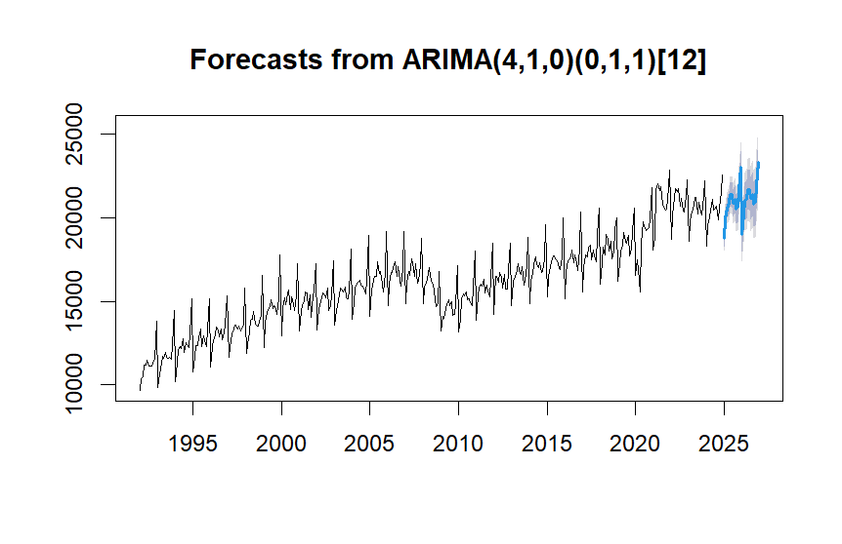
Forecasting for two years (2026/27)

Slide 14
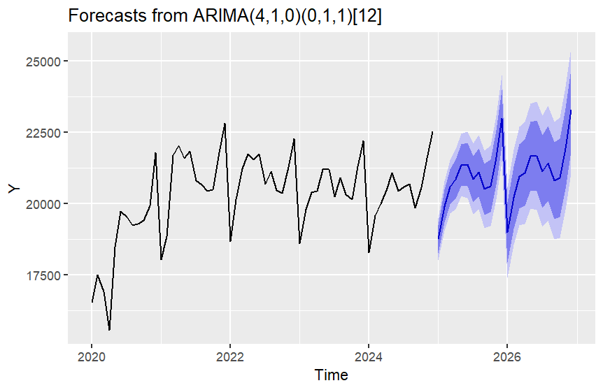
5-Years forecast

